Slide 1


TRUSTLINE,
BY WELLS FARGO
Your Coach, Your Credit, Your Lifeline
Y
Filip Rumenovski
Biochemistry | Wayne State University

Slide 2


Living One Expense Away From Crisis
Millions live paycheck to paycheck.
An unexpected repair, medical cost, or late fee can spiral quickly.
One bill triggers cascading debt.
An unexpected repair, medical cost, or late fee can spiral quickly.
Stability feels out of reach.
Without a safety net, people live in constant financial anxiety.
C3
Notes:
Millions of people today live just one expense away from crisis. Paycheck to paycheck, without a buffer, stability feels like something always just out of reach. And the danger isn’t just the financial math - it’s the constant anxiety. Every bill, every unexpected charge carries the weight of what if this is the one that tips me over?
I know that feeling personally. For me, it was driving my rickety old car down I-75 in Michigan as an international student. Every little knock from the engine made me sweat, because I knew one breakdown could cripple me financially. That’s the reality for so many: one small repair, one medical bill, one missed paycheck, and everything unravels.
This is the problem Trustline is built to solve - not just access to cash, but the fragility underneath it.

Slide 3

Not Just Another Quick Loan App.
Access to cash isn’t the solution.
Quick advances without support don’t build stability.
An advance without guidance just keeps you stuck.
Without coaching, customers stay stuck in the same cycle.
People need a system to get ahead.
Lasting progress comes from tools that build habits, not just loans.
C3
Notes:
Simply giving people quick access to cash doesn’t solve the problem - it just buys time.
I knew if I got an advance without changing my financial habits, I’d be right back in the hole. That’s the trap of payday loans and quick-fix apps: they don’t build stability, they just prolong the struggle. What’s really needed is a system - something that guides you, helps you build discipline, and rewards your progress.

Slide 4

We help you build better habits.
Then, we have your back when life happens.
C3
Notes:
This is the rhythm of Trustline. It doesn’t begin by handing out cash - it begins by equipping you to make the choices that move you closer to where you want to be.

Slide 5
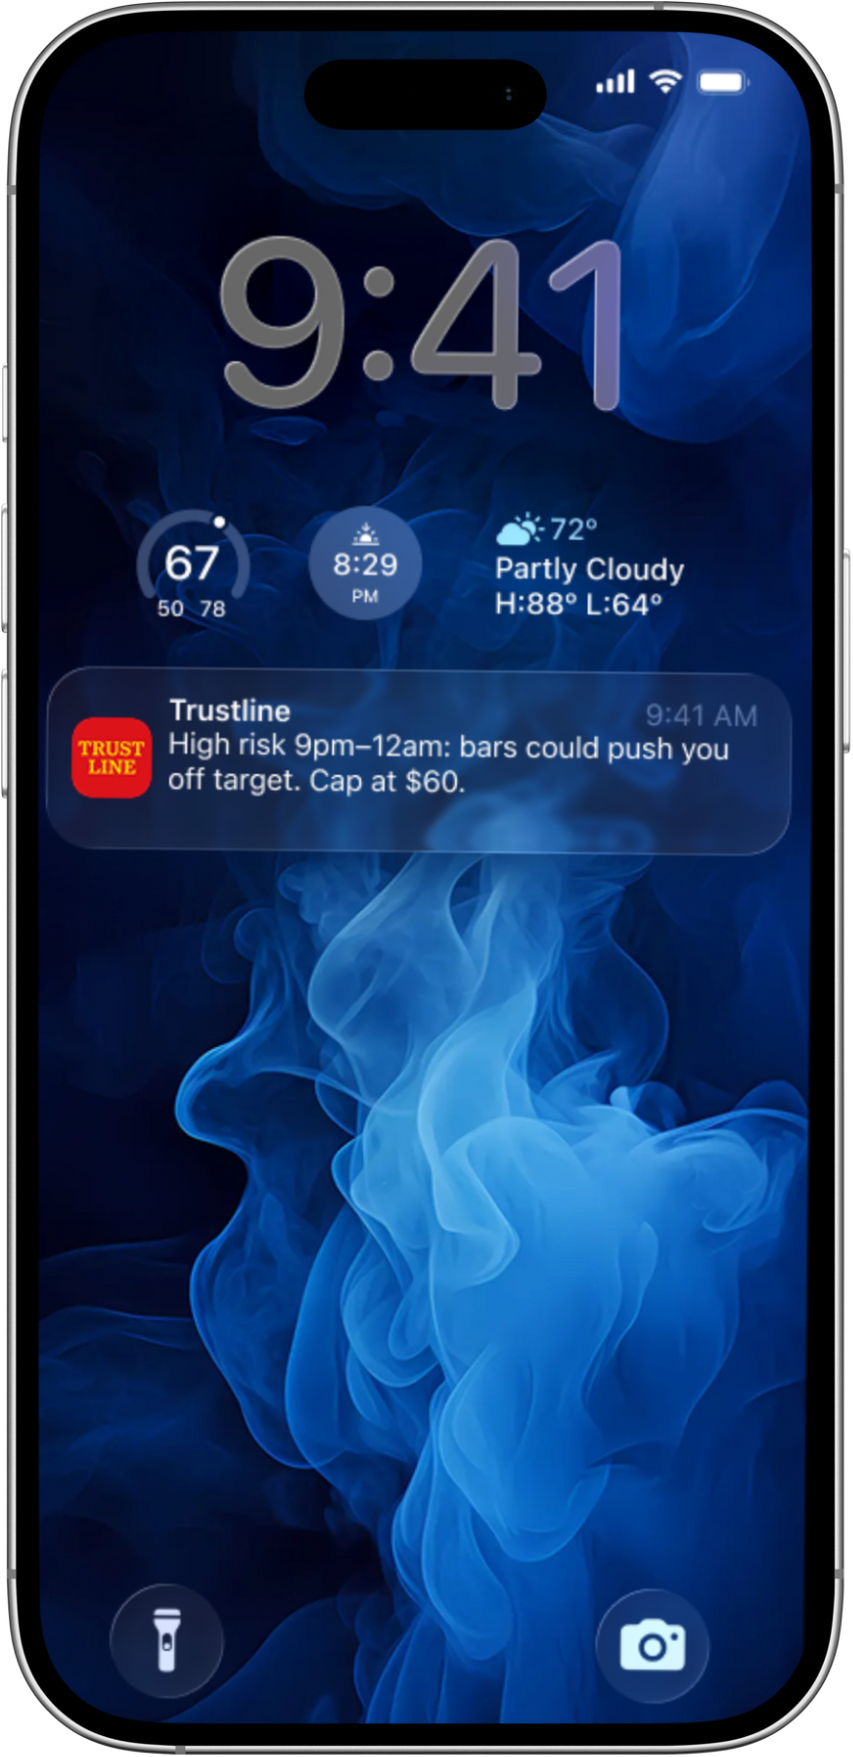
Matching your commitment to a better future.
A Better System.
Trustline reviews your transaction patterns, like a financial coach reading your playbook.
The model spots when overspending risk is rising — before it happens.
A time-sensitive notification guides you back on track.
C3
Notes:
Trustline is built to feel simple, but powerful.
For the user, it starts with foresight: the system scans spending patterns and predicts risk before it turns into a crisis. Instead of waiting until you overdraft, Trustline steps in early with a timely nudge - a time-relevant message that helps you make one better choice in the moment.
As those choices stack up, your Coach Credit Score grows - a clear signal of the trust you’re building. And when life inevitably hits with an unexpected bill, a car repair, or a gap in pay, Wells Fargo is there with fair, fast support that you’ve earned. The essence of Trustline is progress and partnership - it grows with you, step by step, building confidence and long-term stability.

Slide 6

TRUSTLINE UNDER THE HOOD
1. Analyze real transactions with nuance
2. Classify essentials vs. discretionary behavior
3. Evaluate against user goals (savings, stability, buffer)
4. Predictively nudge: encouragement, redirection, or alert
Analyze
Classify
Evaluate
Predict
C3
Prototype model already built - link at the end.
Notes:
Under the hood, Trustline is more than an app with good intentions - it’s a machine learning system designed for real-world nuance.
Every transaction is analyzed and intelligently categorized: recurring bills and necessities flow through as stable anchors, while discretionary categories like bars, entertainment, or late-night delivery are weighted more heavily. The model evaluates these patterns against the goals the user has set - saving for stability, avoiding overdrafts, or building a safety buffer. When it sees behavior that drifts away from those goals, it generates a risk signal and translates it into a precise, time-sensitive nudge - a calm encouragement when things are on track, a gentle redirection when patterns start slipping, or an urgent alert when risk is imminent.
This pipeline - analyze, classify with nuance, evaluate against goals, and predictively nudge - is lightweight and achievable with today’s ML tools. And critically, it’s built on data Wells Fargo already holds, used only with customer consent. That’s how Trustline transforms raw spending into foresight, turning patterns into progress in real time.

Slide 7

Coach Credit Gives You Real-Time Momentum
Grounded in real choices → verified through transaction history
Nimble → progress recognized in days and weeks, not years
Unlocks support → real-time score enables fair, fast micro-advances
Complementary → works alongside FICO as a behavioral trust signal
C3
Notes:
Coach Credit grows when users follow nudges in real life.
It’s measured through verified behavior: skipping that extra delivery or moving money into savings after a prompt. Each action strengthens the score. Unlike traditional credit, where progress takes years, Coach Credit is nimble - momentum is recognized in days and weeks. That makes it motivating, because small wins add up quickly.
The score is tracked in real time, showing who a customer is becoming, not just who they were. And that credibility unlocks access to fair, fast micro-advances when needed.
This doesn’t replace FICO - it complements it. Traditional scoring remains the foundation, while Coach Credit adds a trust signal that lets Wells Fargo extend support faster and more fairly.

Slide 8
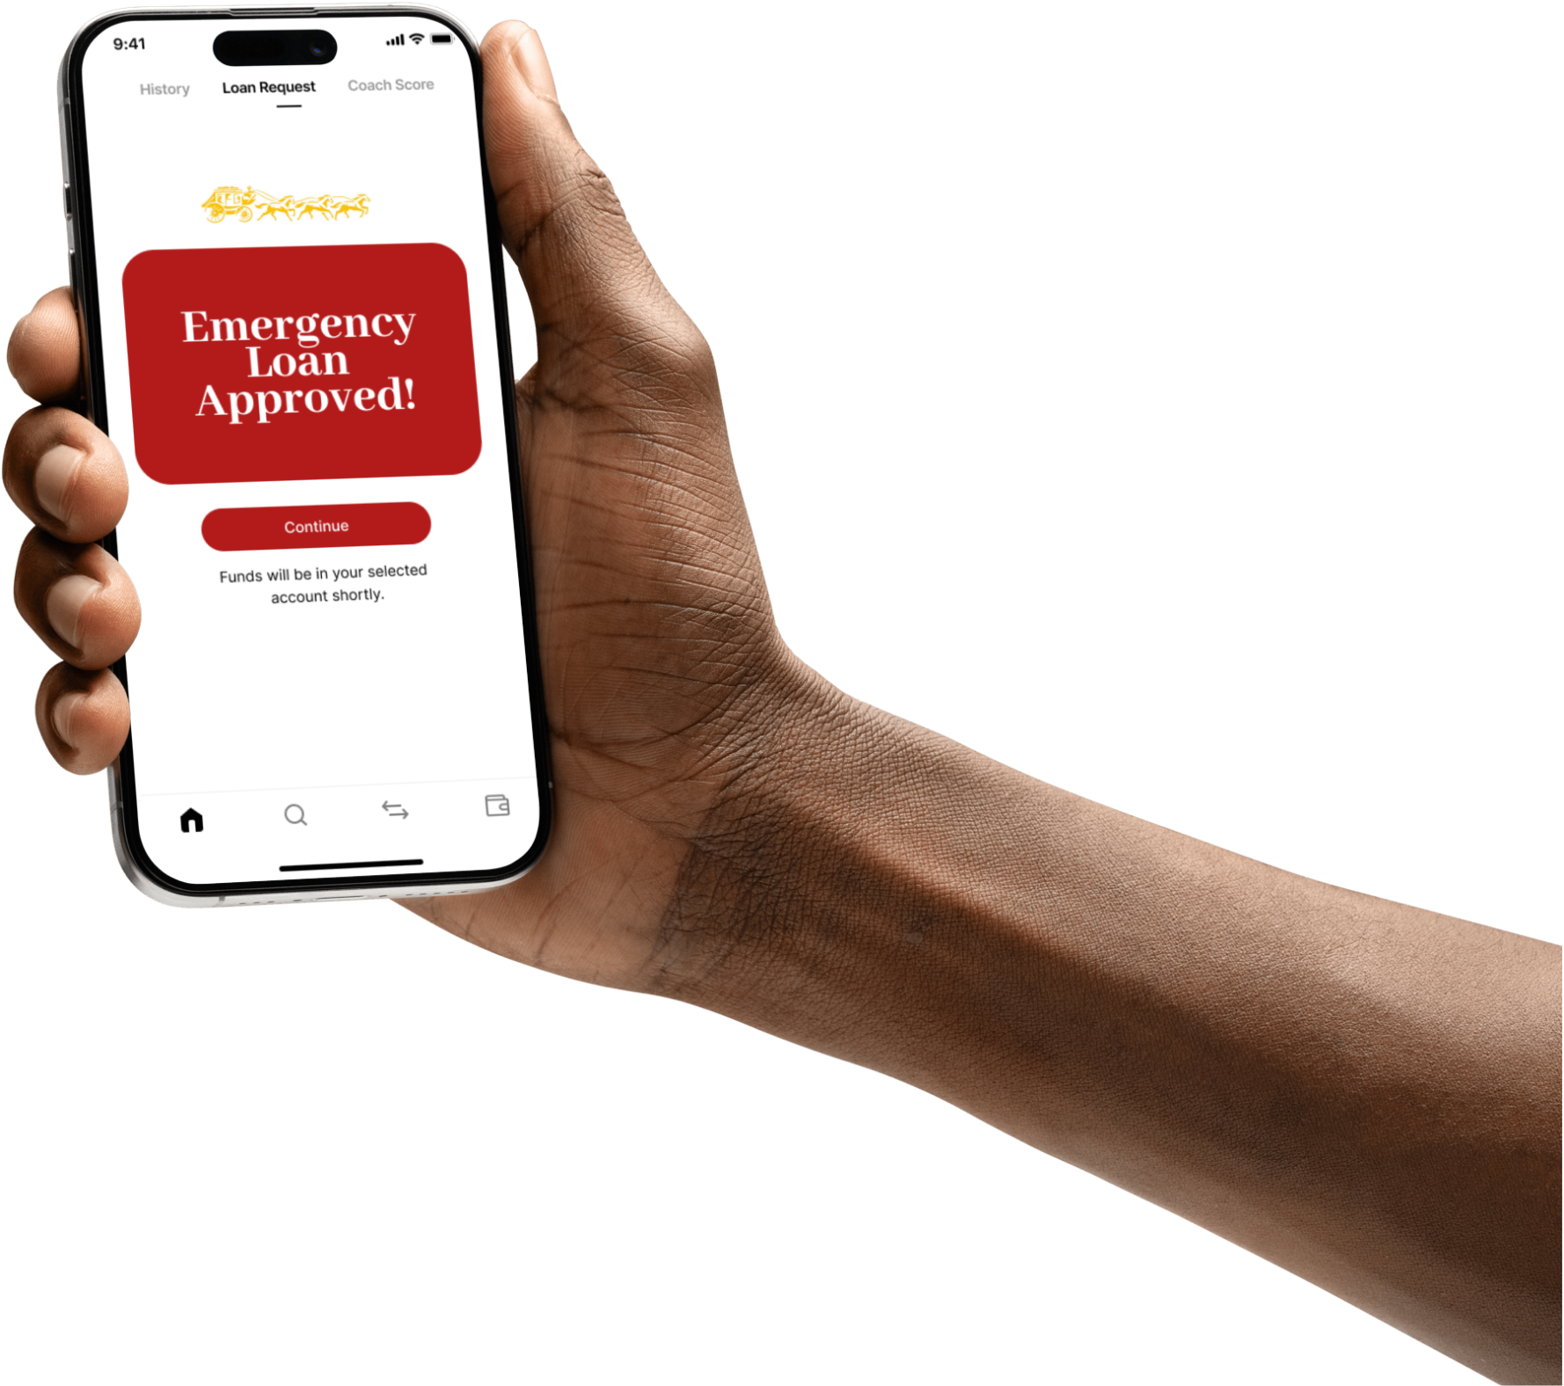
One Tap to Stability
No hidden fees.
Transparent terms, no fine prints or surprises.
Funds in minutes.
Advances delivered quickly, right when they’re needed.
Trust grows with every advance.
Each successful repayment, strengthens the client’s standing.
C3
Notes:
Support is unlocked with a single tap. When a customer requests an advance, Trustline instantly checks their Coach Credit alongside traditional risk measures. Because the score is tracked in real time, Wells Fargo can extend fair micro-advances with confidence. The experience for the user is simple - a clear confirmation, no hidden fees, and funds delivered within minutes through existing payment rails.
Importantly, the system also learns from how those advances are used. Transaction data shows whether funds go to essentials like rent or utilities, or toward more discretionary spending. That insight strengthens the model over time - rewarding responsible use, and helping Wells Fargo calibrate future support. Each advance is both a safety net in the moment and a data point that makes the system smarter and more adaptive.

Slide 9

For Anyone Building a Better Future
Helping people build healthy habits, stay steady through volatility, and feel secure in the future.
C3
Notes:
Trustline is broad by design.
It’s not just for those in financial distress - it’s for anyone who wants to build healthier habits and long-term stability. For young people, it’s a way to practice discipline early and build momentum before mistakes become costly. For workers with fluctuating income, it’s a way to smooth volatility. For households balancing multiple obligations, it’s a buffer against the unexpected.
To validate this range, I built out three representative customer avatars in my model, showing how the system adapts across very different circumstances while addressing the same core need: foresight, coaching, and fair support.

Slide 10

Wells Fargo's Mission – in Action
Trust - Made measurable.
Foresight - Delivered responsibly.
Partnership - Bank as catalyst, not creditor.
C3
Notes:
Trustline is Wells Fargo’s mission, in action.
It doesn’t just meet customers where they are - it equips them to become who they want to be. It redefines trust not as a slogan but as a measurable, living signal between customer and bank. It applies machine learning responsibly, not to overwhelm with complexity but to deliver foresight in moments that matter. And it positions Wells Fargo not only as a lender of money, but as a partner in progress - a system that grows with its customers.
That is the future of Wells Fargo’s values made tangible.

Slide 11

Why this matters for Wells Fargo
A loyalty building engine.
Every nudge followed builds trust
Trustline keeps customers inside WF’s ecosystem
Reduces defaults, increases retention
Clients and Wells Fargo grow together
C3
Notes:
The impact of Trustline is twofold. For customers, it means relief in the moment, visible progress over time, and the stability to finally get ahead. But the real power is in what this creates for Wells Fargo.
When customers see Wells Fargo not as a last resort, but as a partner in their growth, loyalty deepens. Every nudge followed and every advance repaid builds a living trust signal - and that trust compounds. The more customers engage, the stronger their Coach Credit grows. And because Trustline works best when Wells Fargo sees the full financial picture, it pulls more of their spending, income, and savings into Wells Fargo’s ecosystem. That’s not just retention - it’s consolidation.
This isn’t just a product - it’s a loyalty engine. It reduces defaults by improving behavior, it prevents attrition to predatory apps, and it builds brand equity that no competitor can replicate. Trustline ensures that when customers grow stronger, Wells Fargo grows stronger with them.

Slide 12
NO MORE SWEATING ON
I-75
C3
Notes:
I started this story on I-75, sweating bullets every time I heard a noise from my car, because one repair could sink me. Trustline is built so no one has to live with that kind of fear. With foresight, stability, and fair support, Wells Fargo can turn that anxiety into progress. No more sweating on I-75 - just customers moving forward with confidence, and Wells Fargo moving forward with them.”

Slide 13

C3
THANK YOU!
The slide deck doesn't do Trustline justice, seriously.
https://github.com/filiprumenovski/Trustline/
Notes:
Thank you. The slide deck doesn’t do Trustline justice - the real work is in the model. In the GitHub repo, you’ll see a logistic regression system that ingests transaction data, engineers time-sensitive features, and predicts overspending risk within the next 3 hours. From there, it generates tailored nudges like the ones we showed in the app demos. It’s explainable, lightweight, and demo-ready - proof that this isn’t just an idea, but a working system Wells Fargo could deploy.”

